Slide 1




FORMADOR SATELITAL 2017
Preliminary Mission & Systems Review
Section 11 – MOS/GDS & FS Software
MDIAE
20 de Diciembre del 2016 - Córdoba, Argentina

Slide 2
Starts | Subject | Speaker
08:45 | Welcome | L. De Ferrariis
08:50 | 01 - Agenda / Review Objective, Process & Success Criteria | PMWG (Roggero)
09:05 | 02 - Implementation Plan (PIP incluye Requirements Tree) | PMWG - SEWG
09:40 | 03 - Mission Scientific Objectives – Requirements: L1 / L2a | MAIE
10:00 | 04 - Requirements: L2b (Systems) | SEWG
10:20 | 05 - Requirements: L2b (SPARD) | MAWG
10:40 | 06 - Requirements: L2b (ERD) | ITWG (Peiró)
11:00 | Coffee Break | ----
11:10 | 07 - Organization Overview (MTS / MIS / MDIAE / MAIE) | Various
11:55 | 08 - Mission Design | SEWG
12:10 | 09 - Payload Concept | MIS
12:30 | Lunch | ----
14:00 | 10 - Service Platform Concept | MTS
14:20 | 11 - MOS/GDS & FS Software | MDIAE
14:35 | 12 - Launch Vehicle | MTS
14:50 | 13 - Safety & Mission Assurance (MTS-MDIAE-MIS) | Various
15:05 | Coffee Break | ----
15:20 | 14 - Academic Phase: Planning | Various
15:30 | 15 - Academic Phase: Performed Activities | ITWG
16:00 | Review Board Caucus | Review Board
16:30 | RFA & Review Board Findings | All
16:50 | End of Day | ----
AGENDA – 16 de Diciembre (Tarde)

Slide 3
MOS/GDS & FS Software – Contenido
Flight Segment Software Architecture
MOS/GDS Software

Slide 4
Flight Segment Software Architecture
MOS/GDS & FS Software
Arias Emmanuel
González Ezequiel
Montilla Alfonso
Sufán Eduardo
Uranga Javier

Slide 5
MOS/GDS & FS Software – FS SW Scope
The Flight Segment Software shall be responsible to send housekeeping data to the ground segment and execute telecommands from it.
The Flight Segment Software main components are:
C&DH Software
Payload Software

Slide 6
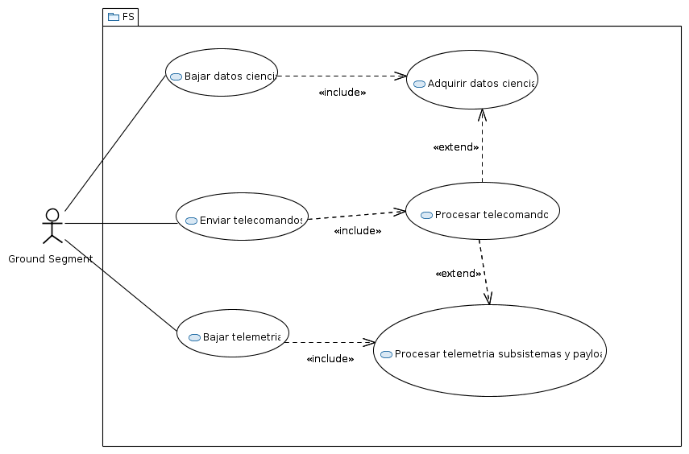
MOS/GDS & FS Software – FS SW Use Cases

Slide 7
MOS/GDS & FS Software – FS SW Requirements
Parent requirements (L2B):
Main subsystems: C&DH and Payload
Default Software in other subsystems
Architecture and Functional requirements details are L3 level specifications.
Designed architecture aims to be as simple as possible, covering all the functionalities demanded to the flight software.
Notes:
Verificar si nadia va a hablar de estos requerimientos

Slide 8
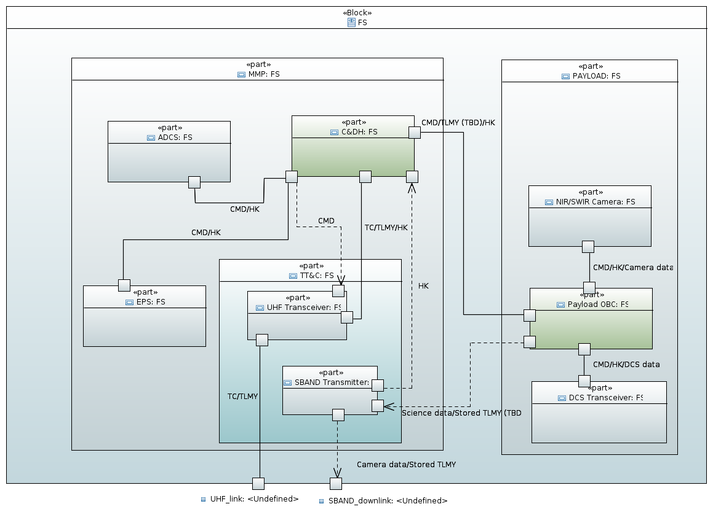
MOS/GDS & FS Software – FS SW Architecture

Slide 9
MOS/GDS & FS Software – FS SW Architecture
Flight Segment Software Modules

Slide 10
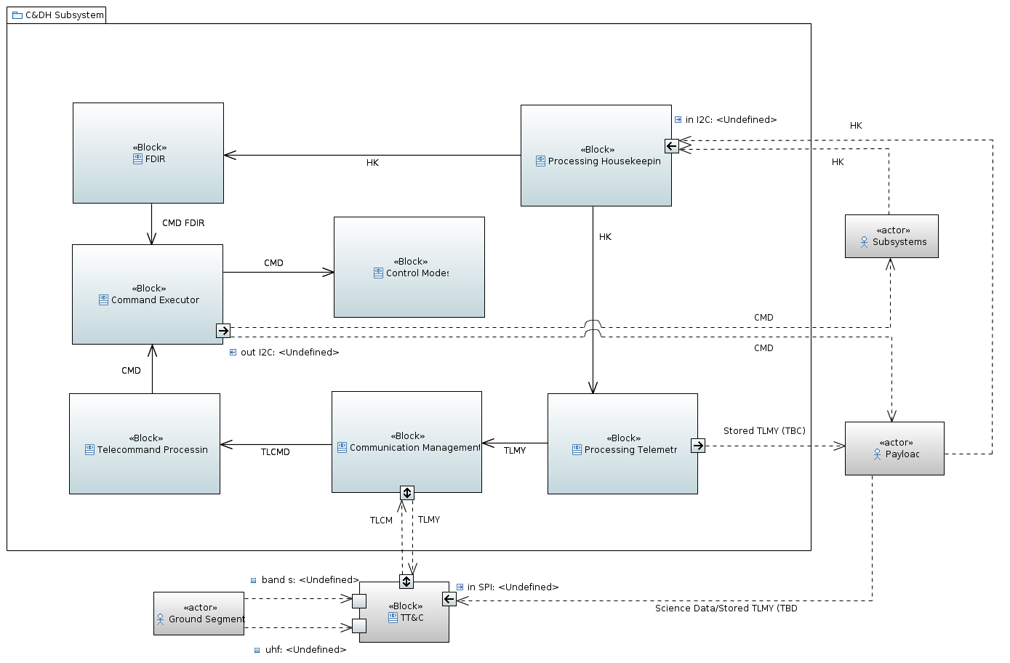
MOS/GDS & FS Software – C&DH SW Architecture

Slide 11
MOS/GDS & FS Software – C&DH SW Architecture
Failure Detection, isolation and fault recovery
Housekeeping
Telecommand processing
Telemetry frame

Slide 12
MOS/GDS & FS Software – C&DH SW Architecture
C&DH
Control modes
Command execution (TT, RT)
Communication management with TT&C

Slide 13
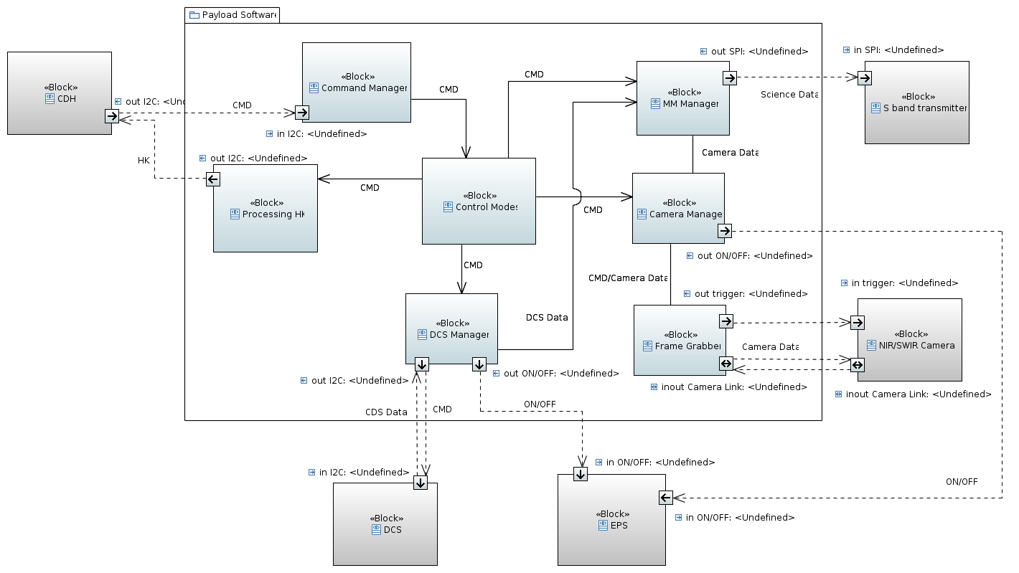
MOS/GDS & FS Software – Payload SW Architecture

Slide 14
MOS/GDS & FS Software – Payload SW Architecture
Mass Memory management
Command management
Camera management
DCS management

Slide 15
MOS/GDS & FS Software – Payload SW Architecture
Housekeeping
Control modes
Frame Grabber

Slide 16
Academic Model

Slide 17
MOS/GDS & FS Architecture – FS SW Academic Model
Flight Segment Software Modules

Slide 18
MOS/GDS & FS Software – FS SW Academic model
Only essential changes in provided software and hardware configuration of EMP, to achieve the end to end test:
Recognition and processing of telecommands directed to DCS payload instrument
Housekeeping data collection from DCS payload instrument
Sending DCS's science data from payload to ground segment
Notes:
Verificar si nadia va a hablar de estos requerimientos

Slide 19
Questions?

Slide 20
MOS/GDS Software Architecture
MOS/GDS & FS Software

Slide 21
MOS/GDS – Outline
Overview
Functionalities
Architecture
Data Flow
UHF
S-Band
Operations Phases

Slide 22
MOS/GDS – Functionalities
The Ground Segment shall be responsible by operations and control of the entire system which includes final products generation and dissemination.
The Ground Segment main components are:​
​
Mission Unit​
​
Control Unit​
​
TT&C Station​

Slide 23




MOS/GDS - Functionalities
Mission Unit
Point of contact and administrative relationship with the users
Support
Delivery times
Calibrations
Collect the user's request
Process science data
Publish science products
Generate mission plans to the payload module
Complete mission data management

Slide 24



MOS/GDS - Functionalities
Control Unit
Satellite operations scheduling
Develop, testing, validation and sending commands to spacecraft
Receive the mission level plan that comes the mission unit to load related activities to the payload module
Monitor the spacecraft state of health
Schedule TT&C service
Orbital parameters generation
Prepare and execute attitude adjustments

Slide 25
MOS/GDS - Functionalities
TT&C Station (Ground Station)
These stations will allow to operate in UHF in order to send telecommands to the spacecraft and receive the housekeeping telemetry from it.
These stations must transfer and decode science data file and storage telemetry data from CONAE FTP server to Mission Unit.
These stations must have recording capabilities and available resource during by 24 hours a day, seven days a week, in order to attend the satellite visibility cycles during entire mission lifetime.
These stations will allow to generate a pass log file in order to audit purposes.

Slide 26
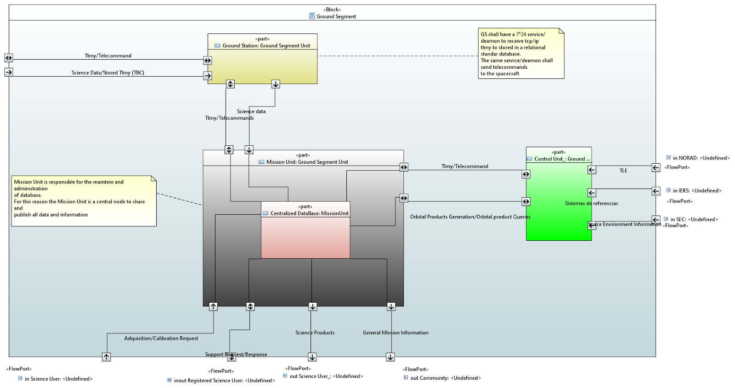
MOS/GDS - Arquitecture
UHF
TT&C
FTP
Norad
Control Unit
IERS
Mission Unit
External science app
Community

Slide 27
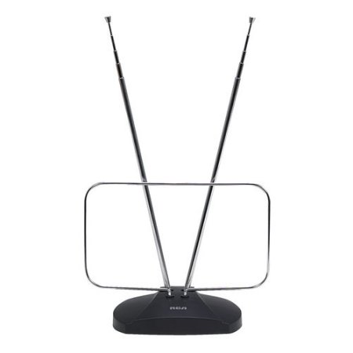


MOS/GDS – Data Flow
TT&C
FTP Server
Science Users/Community
WebServices
Operators/FE, Orbits Dynamics

Slide 28

MOS/GDS – Data Flow (Academic model)
TT&C
FTP Server
Send telecommand
Receive and persist telemetry
Receive and persist science data
Publish Data (Restful/SOAP-TBD)
Science Users/Community
WebServices
Operator
MAIE WebGis

Slide 29
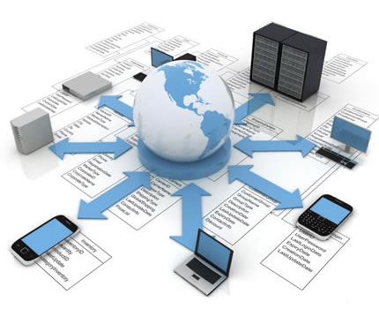
MOS/GDS – Goals/Benefits
Normalized, centralized and common repository
Tools integration (Interoperability)*
User authorization*
Flexible collections via queries*
Change control and transaction audits*
Data integrity
Backup, recovery, replication
Cost
*Space Mission Operations DBMS, SpaceOps2006, David Roland
Notes:
Software independent

Slide 30
MOS/GDS – Operation phases
LEOP
To find the spacecraft
Early orbits determination
Incremental testing functionality
Commissioning Operations
Acquisition
Nominal Operation
Decommissioning

Slide 31
Questions?

Slide 32
BACK UP SLIDES

Slide 33
MOS/GDS - Functionalities
Mission Unit
It is responsible for the relationship to the end users, the definition of the payload operations and the defined products generation, storage and distribution. Also the mission data storage, administration, backup and recovery.

Slide 34
MOS/GDS - Functionalities
Control Unit
It is responsible to set up and manage the system activities schedule, prepare the on-board and ground operations plans, execute the ground operation plan, generate the Flight Rules & Constraints list and monitor & maintenance of the satellite state of health.

Slide 35
MOS/GDS - Functionalities
TT&C Station/Ground Station
It is responsible to receive, demodulate, and record spacecraft data telemetry, telecommands and science data (telemetry and telecommands by UHF, science data by S-Band). It is also responsible to track and provide the spacecraft orbital position (TBC).

Slide 36
MOS/GDS – References
Development and Testing of Satellite Operation System for Korea Multipurpose Satellite-I
Nasa, Open MCT, https://nasa.github.io/openmct/
Database Administration for Spacecraft Operations – The Integral Experience
Reusable toolset for an Easy-to Build Payload Ground Segment
Satellite Mission Operations Best Practices
A Database Center Approach to Satellite Engineering Data Storage, Access and Display
Case Study of RDBMS Use on The EUVE Mission

Slide 37
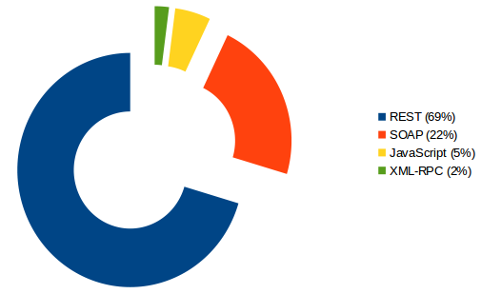
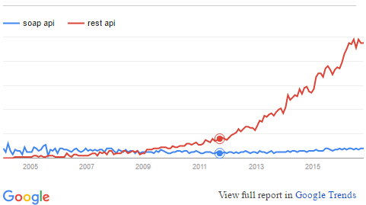
MOS/GDS – Applications Interfaces
The XML vs. JSON debate is one of the bigger topics in developer circles during the last decade. Although XML has several advantages, such as being a defined standard since 1996, JSON's lighter approach has proved popular
Adam DuVander/Google Trends

Slide 38
MOS/GDS – Backup Slide
DBMS
Historically, these applications have been loosely coupled via flat files in various formats. This inter-group communication often requires transformations between operational steps. The locally developed software written to do this creates issues of validity, consistency and accountability. The use of these files slows down operations, introduces opportunities for errors, makes isolating subsets difficult, and increases the effort to manage the mission.
Space Mission Operations DBMS (SMOD)
David P. Roland
Computer Sciences Corporation

Slide 39
MOS/GDS – Backup Slide
DBMS
A database provides a centralized repository for all information about satellite engineering telemetry. Despite a single
physical location, this repository can be made accessible from anywhere. Also, a commercial quality database provides access to optimal implementations of many functions that would otherwise be very difficult to write. Compression, logarithmic search, and an abstraction from physical representation are automatically maintained, preventing problems with file management and data access that can be a major source of difficulty in software development for satellite missions.
A Database Centered Approach to Satellite Engineering Data Storage, Access, and Display
University of California at BerkeleySpace Sciences Laboratory

Slide 40
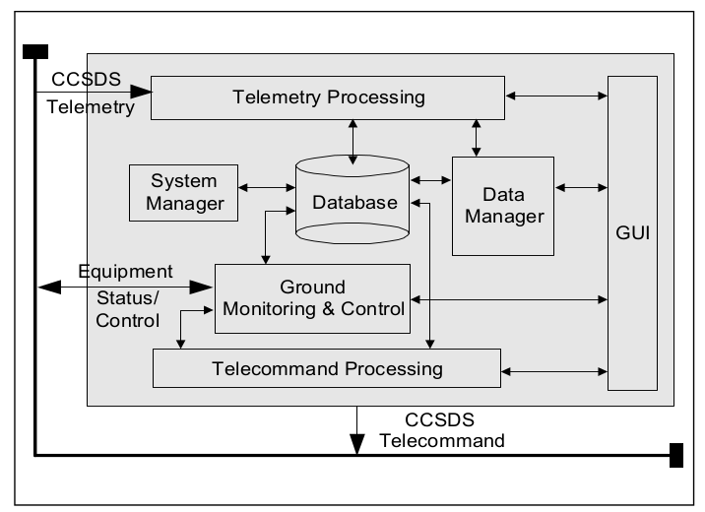
MOS/GDS – Backup Slide
To achieve flexibility with respect to replacing or upgrading an application, a database driven structure was adopted as the baseline architecture in order to formulate a generic machine independent, mission specific database. This approach allows the generic process engine to be used from one program to an-other and enhances the expandability by making provision to add or replace the mission specific parts. The SOS application program was designed to access a database to get satellite-specific data through network SQL primitives.
The DBMS provides and maintains data relation ships required for intelligent or autonomous functional implementation, as well as database security and integrity. The data bases populate the satellite parameters and characteristics, the spacecraft operational information like alarm limit and display configuration, telemetry and telecommand characteristics data, and some relations featuring an automatic detection of a failure and telecommand verification. The telemetry state-of-health data of KOMPSAT-I is also managed by the DBMS for con-
current access from multiple users.
Development and Testing of Satellite Operation
System for Korea Multipurpose Satellite-I

Slide 41
MOS/GDS – Backup Slide
DBMS
Relational databases (e.g. ORACLE) were introduced in the late 1980s with the development of the SCOS-1 infrastructure and are still being widely used in ESA. The use of relational database technology has opened the door to a progressive increase of the automation in the creation and maintenance of
the spacecraft databases. ORACLE, in particular, supports a powerful query language
(SQL), which allows interrogation of the database and the manipulation of all data
meeting specified criteria (bulk data editing). It also supports a development environment,
which has been used extensively to produce the editor forms.
Database Administration for Spacecraft
Operations – The Integral Experience r
bulletin 103 — august 2000
100
Database Administration for Spacecraft
Operations – The Integral Experience
J. Houser & M Pecchioli
Mission Operations Department, ESA Directorate of Technical and Operational Support,
ESOC, Darmstadt, Germany
http://www.esa.int/esapub/bulletin/bullet103/houser103.pdf

